Slide 1
BUILD X : ANDROID
https://tinyurl.com/android-blank-project

Slide 2

Welcome! Introductions are in order :)
My name is Shakeel.
2nd Year Computer Science student.
VP @ KCL Tech.
https://tinyurl.com/android-blank-project
Notes:
Best photo I could find… Just went downhill from there :P
Emphasis on 2nd Year student – I’m a bit new to this teaching thing (next slide)

Slide 3
I’m a bit new to this teaching thing
I have 5 years programming experience in total
3 years with Java
About a year’s worth of time playing with Android apps…
…and approximately 0 hours of teaching experience! :D
https://tinyurl.com/android-blank-project
Notes:
Before you bolt out of the door, I do have decent programming experience ☺
This is my first teaching experience.
Which means… I need your help! (next)

Slide 4
I need your help!
If what I’m doing isn’t working, please let me know!
In person, on Facebook, anywhere really.
My aim is to help you understand, if I’m not doing that, please tell me so I can learn how to better help you :)
https://tinyurl.com/android-blank-project
Notes:
Aim: Let me know if I’m doing things wrong. My aim is to help you understand, help me learn how to better help you. This is a learning environment for all of us.

Slide 5
What is this course anyway?
This is a beginner's guide to developing Android applications. You do not need any prior mobile development knowledge or experience.
However, this is not a beginner’s guide to programming!
Mobile apps are not the best place to start learning how to code for the first time.
https://tinyurl.com/android-blank-project

Slide 6
What is this course anyway?
The languages used in this course will be Java and XML.
This will not be an in-depth guide to either language.
Side note: Java instead of Kotlin as I don’t have enough experience with Kotlin to teach it. I might do an overview near the end of the course, we’ll see how it goes ;p
https://tinyurl.com/android-blank-project

Slide 7
Is this course for me?
Some experience with Java/any similar object-oriented language (C++, C#, etc) would be favourable.
Some general programming experience is also great (Python, JS, etc) although some concepts might take a bit more time to grasp.
https://tinyurl.com/android-blank-project

Slide 8
Is this course for me?
If you feel you can understand and respond to these questions, you’re in a perfect position to follow this course:
Can you briefly describe the different primitive types? (ints, Strings, booleans, doubles, chars, etc)
Do you know what a class is?
Do you know what inheritance is?
Do you know the difference between a “for loop” and a “while loop”?
https://tinyurl.com/android-blank-project

Slide 9
What is this course anyway?
The best way to learn Android is to get stuck in and start playing with it – and that’s what we’re going to do.
Throughout this course, we will work together on a project: a todo app.
Everyone will build their own app, and there will be chances for you to customize and experiment.
We’ll build step by step, exploring features along the way.
https://tinyurl.com/android-blank-project

Slide 11
Let’s get started!
https://tinyurl.com/android-blank-project

Slide 12
Components of an Android App

Slide 13
Components of an Android App
Main categories:
Activities
Layouts & Views
Resources
We’ll focus on Resources today.

Slide 14
Activities - Overview
One of the basic building blocks of an Android app.
Can be thought of as a distinct page in your app.
They have layouts (providing structure) which contain many views, they can handle user interactions, and users can navigate between them.
They have a fairly complex lifecycle.
The most important thing to know is that activities can exist in the background without being fully closed.

Slide 15
Layouts & Views - Overview
A layout tells the device how things should look – an activity, fragment, custom view, etc.
Layouts are made up of views, some of which can contain other views (this is called a View group). For example, a TextView displays text, it is a simple view so it cannot contain other views. However, a LinearLayout is a view group, so it can contain other views. ( A LinearLayout displays it’s children views in-line, either horiztontally or vertically)
Views can be given custom-ids, so they can be referred to throughout your code.

Slide 16
Resources
Resource files define the visible elements of our application.
Strings, numbers, Booleans
Sizes for items
Styles for appearances of elements on screen
Layouts and Views

Slide 17
Resources
Resource files are written in a mark-up language called XML (eXtensible Markup Language).
Similar to HTML, XML structures data within tags.
(In fact, HTML is a type of XML)

Slide 18
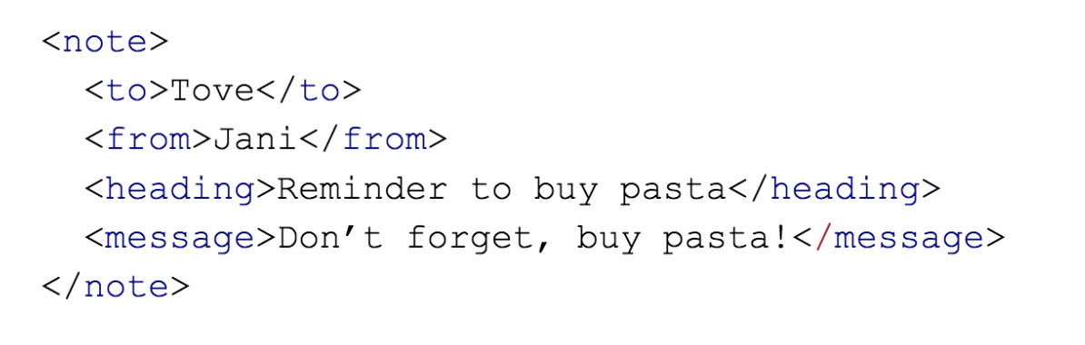
Resources - XML
Here’s an example of XML that describes a note:
As you can see, it’s fairly self-descriptive. You can see it’s to “Tove”, from “Jani” and it’s heading
is “Reminder to buy pasta”.

Slide 19
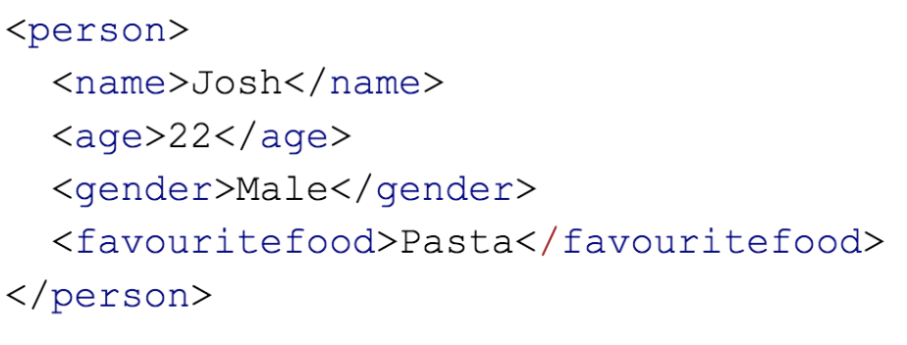
Resources - XML
You can describe anything in this fashion. For example:

Slide 20
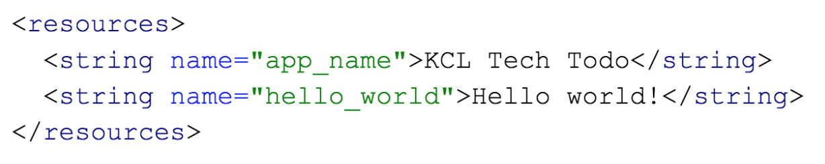
Resources - XML
When writing in Android, we use XML in the same manner.
For example, we have an XML resource to hold all of our strings (text). Here’s an example:

Slide 21
Resources - XML
We have the same format, but there is some extra detail in our tags.
The name part of our <string> tag is called an attribute.
Attributes contain data relating to specific objects in our XML. In this case, we know the <string>tag
containing “Hello world!” has the name ”hello_world”.
We can refer to this string by that name in other parts of our code.

Slide 22
Let’s explore this project :)

Slide 23
Exercise
Your challenge, should you choose to accept it:
Verify you can run the app on your phone or emulator
Change the text in some way, via the XML resources. You could change the size, the colour ( see http://www.colorpicker.com for help getting colour codes), the wording, or all three!
Add a <Button> below your text view, and set the label on it using a string resource.
Challenge: Give the button an ID, ”find” the button in your activity Java code, and make it do something when you press it (search ”Android toast” online for some ideas)
The KCL Tech team are here to help - just wave your hand or shout at us :)

